Slide 1
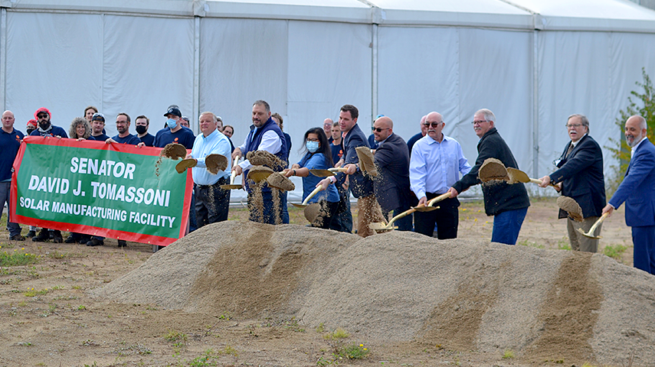
Building Back Better: Regional Cooperation in Northeast Minnesota
How We Didn’t Get a Grant But Did Figure Out a Lot of Other Things
Notes:
Add in intros, who are we, why do we do what we do, background

Slide 2
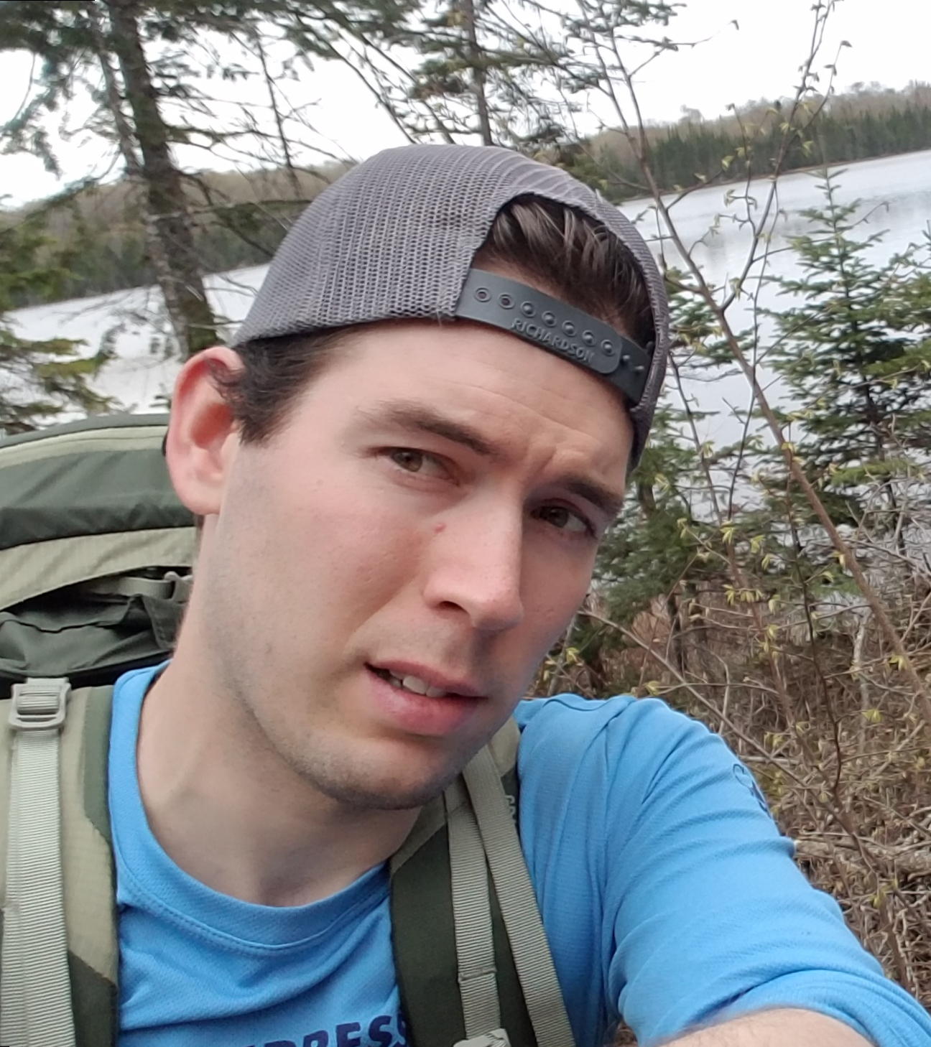
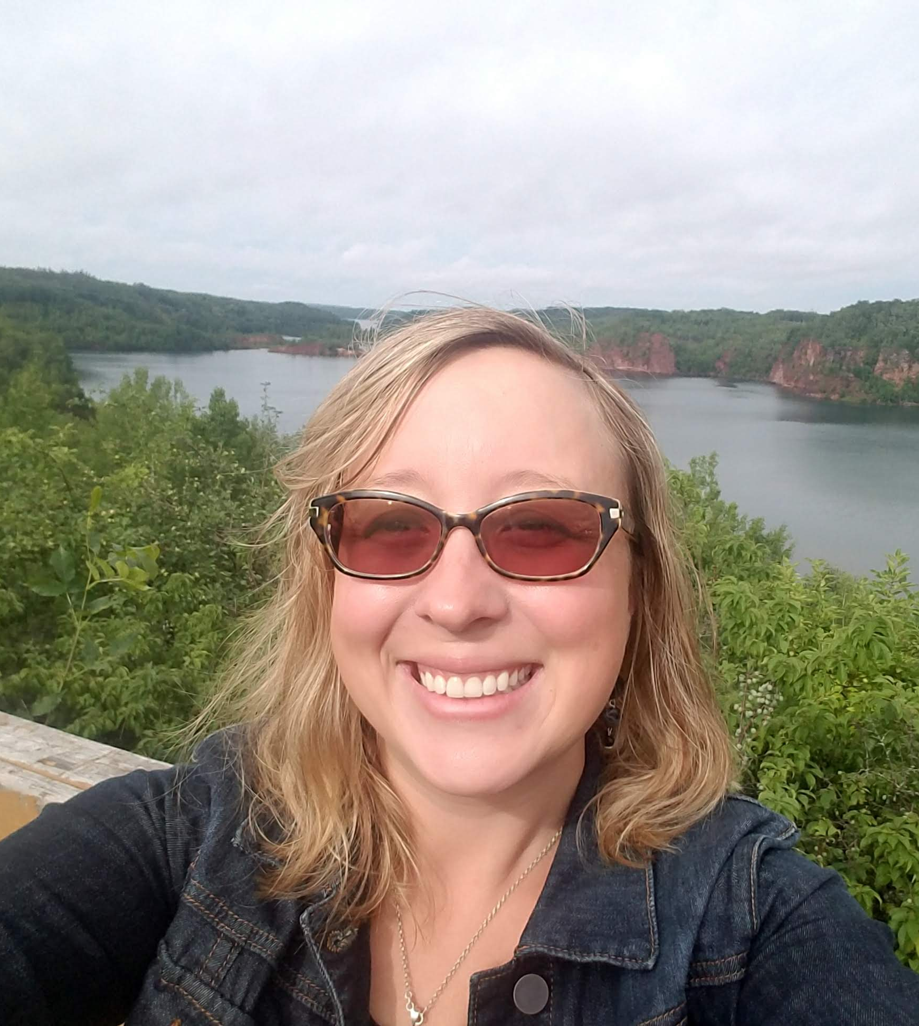
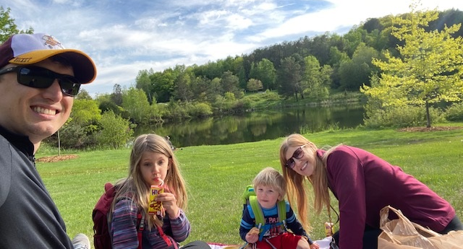
Our Northeast Minnesota Stories
Arik Forsman, Regional Development Lead, Minnesota Power
Whitney Ridlon, Community Development Representative, Dept. of Iron Range Resources & Rehabilitation
Karl Schuettler, Research Director & Senior Consultant, Northspan
Notes:
Here we are – tell our stories and our ties to rural

Slide 3
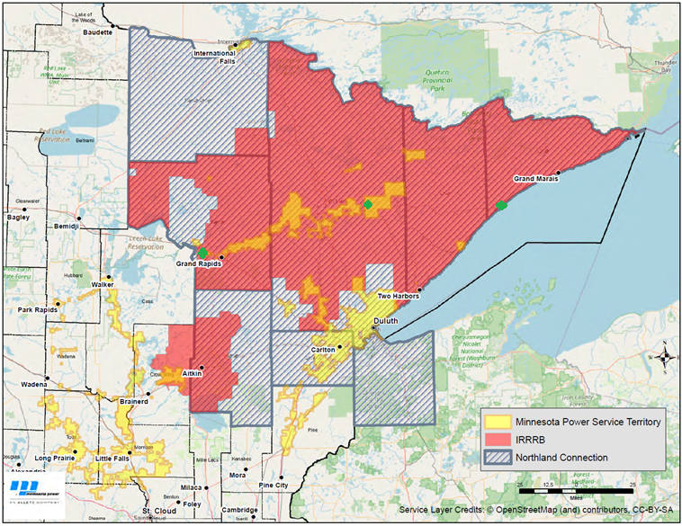
Our Region
Notes:
We are a rural area the size of West Virginia. 70 cities, 180 townships, and five tribal nations (Leech Lake, Fond du Lac, Mille Lacs, Bois Forte, and Grand Porta
ge). The region has a robust industrial sector tied to the area’s abundant natural resources.
Pandemic was a good time to do this……blueprints going forward. Fast tracked what pre-pandemic would have been logistically more difficult to coordinate.

Slide 4
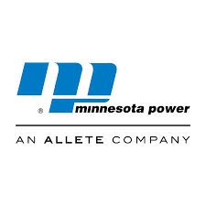
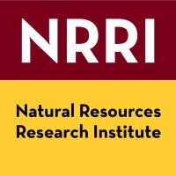
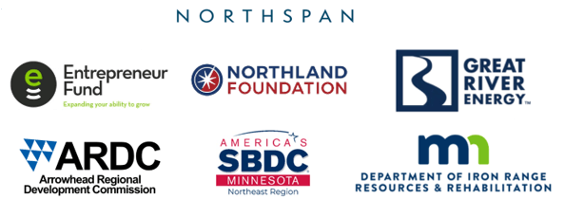
Regional Partners
Notes:
Partners not programs???

Slide 5
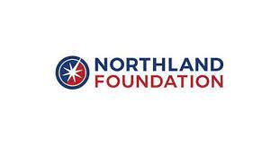
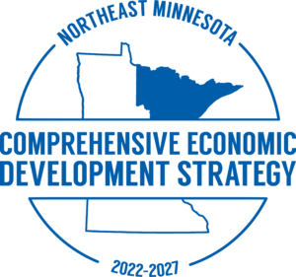
Regional Planning
2017: Recharge the Range
2018-2020: Blandin Broadband Communities
2021: Comprehensive Economic Development Strategy (CEDS)
2021: Arrowhead Intelligent Region
2021: Statewide Energy Transition Office Established
Notes:
2017: Recharge the Range
Regional Planning Effort led by regional Economic Development Partners with Business & Community Leaders
Improved broadband shared priority
Trails, Downtown Revitalization, Childcare
2018-2020: Blandin Broadband Communities
10 NE MN Communities
Grants to increase use of technology
Grants to support broadband infrastructure planning
2021: Comprehensive Economic Development Strategy (CEDS)
Engagement & Planning effort
List Major Outcomes from Josh B
2021: Arrowhead Intelligent Region
Broadband enabled economic development planning
Grants to support technology use in alignment with broadband enabled economic development
2021: Statewide Energy Transition Office Established
BBB was based on planning efforts and resulting initiatives over the past 5 years.
1. ReCharge Recommendations focused on regional branding, small business strategies include increased support for local business/entrepreneurs, prioritization of natural resource based economy opportunities, increase customized/certificates and advanced degrees on the range & better alignment with employers, reinvest and revitalize downtowns, invest in trails, invest in broadband. This effort led to increased investments in QOL and overwhelming all participates stressed the need for improved broadband.
Subsequent to RR, the agency and blandin foundation partnered on the BBC program.
Next, up the regional partners all got together again and worked on the updated CEDS – this included unprecedented community engagement across the region – DURING COVID!!!!!
At the same time as CEDS, the agency, blandin, and northland partnered on the AIR which led to regional planning that acknowledges broadband is the undelining thread that will attract workers, allow for innovation, address rural digital equity, encourage sustainability, helps marketing.
Additionally, the State of MN established the Office of Energy Transition and conducted a detailed study on best practices for coal impacted communities – of which our region has 3 biggies (Cohasset, East Range, & Tac Harbor)
The reason I go over this is that for BBB, we built on existing initiatives that aligned or were derived from recent planning/engagement. All partners were more or less involved in these planning processes.

Slide 6
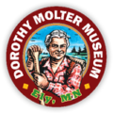
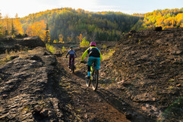
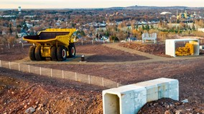
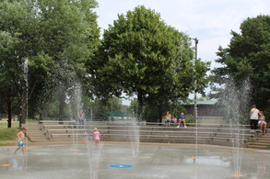
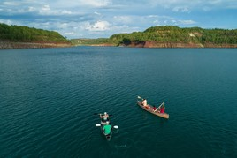
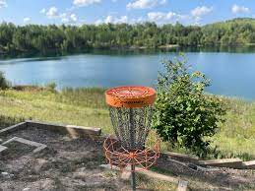
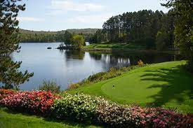
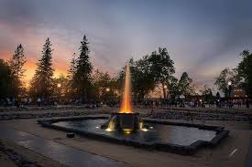
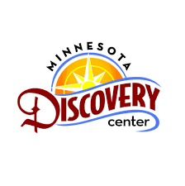
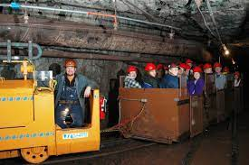
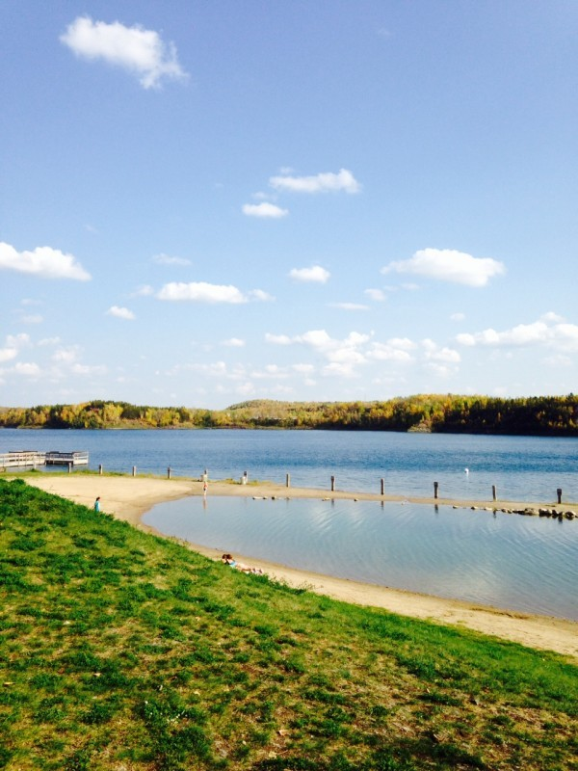
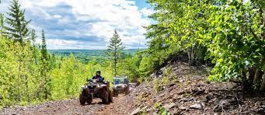
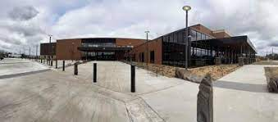
Recreation via Reclamation, Trails, Culture & Tourism
Notes:
The region has been positioning itself over the years via increased investments in generally what we could define as Community Development/Quality of Life efforts. This concept, has been continually catching steam as a legit economic development strategy and has been further brought forward after the pandemic and aligns with the work U of MN extension Ben Winchester is doing around rural brain gain which shows People migrate to rural communities for 1) a simpler life, 2) safety and security, 3) affordable housing, 4) outdoor recreation and 5) quality schools.
Communities can work together to attract newcomers and create a quality of life that all residents enjoy.
QOL Investment have centered around Recreation via Reclamation, Trails, C&T, downtown revitalization (beautification and building rehab), childcare, education, and broadband!
I want to note that investment in traditional business development efforts & core community infrastructure (sewer/water) continued on. These are just areas where investment was newer or emphasized more!!! We will talk about those efforts down the line.
- Over $2 million in regional and community trails (MT Bike Trails in Cohasset, Chisholm, & Biwabik, also ATV, Snowmobile, XC Ski, walking, etc.
Tioga: Cohasset, MN - Coal Impacted
Cuyuna: Crosby, MN
Giants Ridge: Biwabik, MN – Coal Impacted
Increased investments in culture and tourism and community amenities – historic preservation, community art, community recreation like playgrounds, pickleball, tennis courts, splashpads, tourism destinations support like the Wolf Center, Bear Center, Dorothy Molter, MDC, Giants Ridge, etc.
Continued investment in mineland reclamation – ie: Recreation via Reclamation – investment in the mine pit lake access, stocking the pits with fish, campground expansions, mineview overlooks/access, disc golf course along the pits, etc.

Slide 7
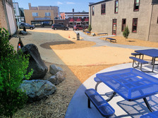
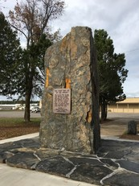
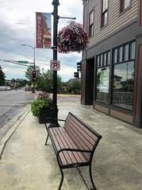
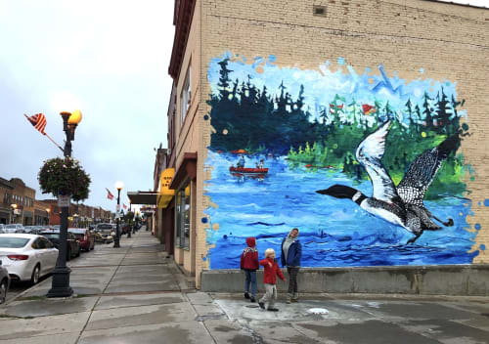
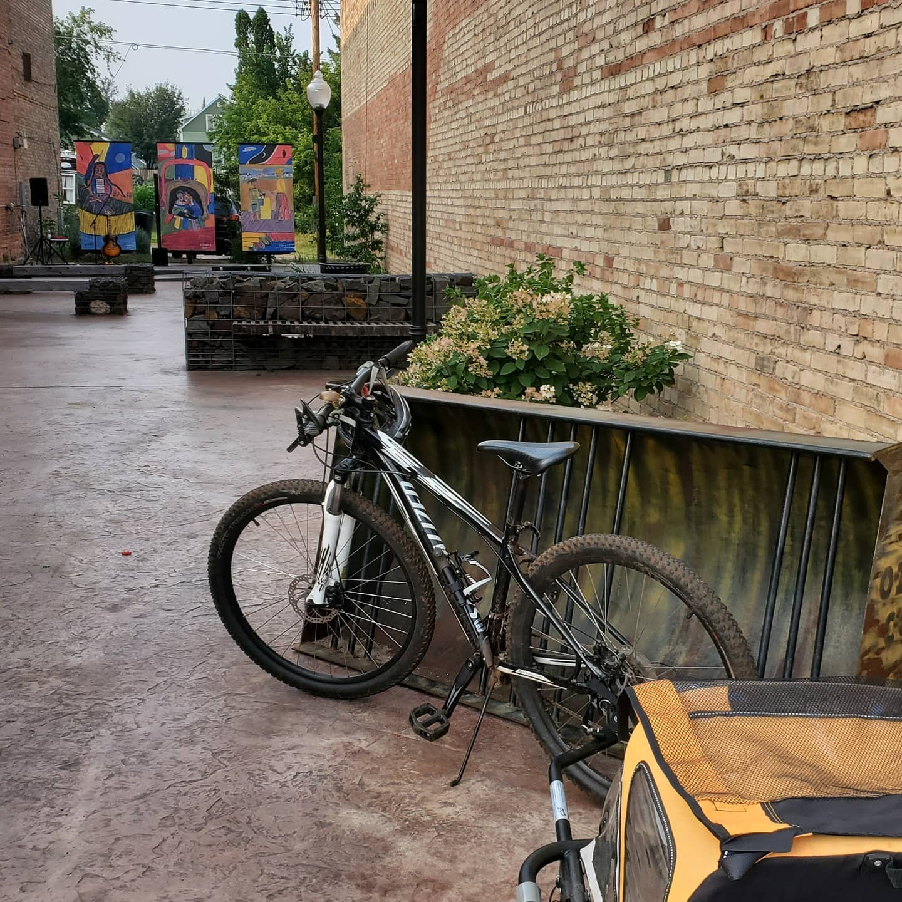
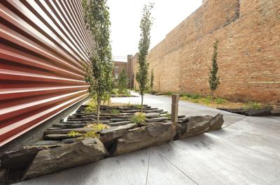
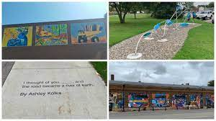
Downtown & Business Corridor Beautification
Notes:
Our region has Old Downtowns - How to spur life back into them. We invited up Strongtowns and listened to their messaging – the agency started a grant program to invest in downtown beautification – things funded were public art, pocket parks, banners, signage, benches, downtown sound systems, etc. small If the community shows love – businesses are more likely to invest. One City painted just the façade of the building and next thing we new the owner put in up for sale - LOL, take your community destiny into your own hands (small, low capacity communities – quit blaming yoru elected and clerk (when we know they are stuggling to just keep the city running and start doing).
Downtowns Investments to create attractive environments for workers, shoppers, visitors, – pocket parks, community art, downtown beautification, wayfinding signage, benches, historic walking tours, etc

Slide 8
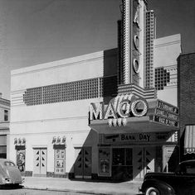
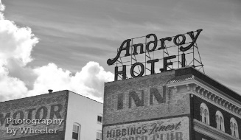
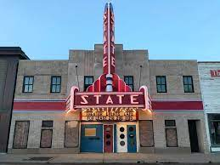
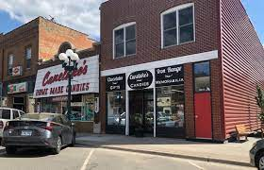
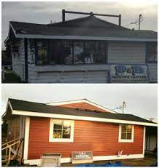
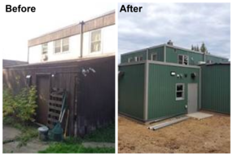
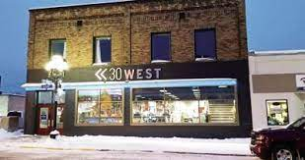
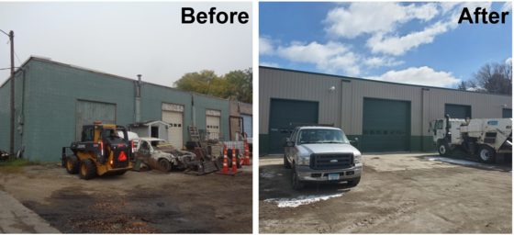
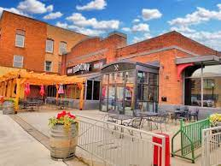
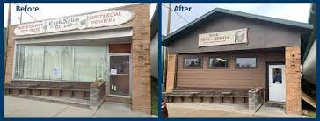
Building Rehabilitation
Downtown Building Rehabilitation
Program
$9 million grants since 2014
$48 million total project investment
450 projects
Notes:
We know beautification alone is not going to be the only tool. Our downtowns have insanely Low Building Values – its often Cheaper to Build New, these buildings have ineffient heating sytems, high cost code upgrades (lifts & sprinklers), etc. Our region has funding for energy retrofits and code compliance upgrades to help encourage reinvestment into our core downtowns and business districts. Our small business owners often do not have the funding or cannot obtain the bank financing to make investments these buildings need. If we do not do something, we will have intertubes of development around every community.
Note STATS.
BER: The grant helps communities improve and modernize their business assets through building energy efficiency improvements. The grant resulted in reduced utility bills, improved building aesthetics and increased building life for businesses across the service area. The region’s downtowns and business corridors were enhanced, and Minnesota’s environment was potentially improved. BER is funded by Iron Range Resources & Rehabilitation and administered through a partnership with Arrowhead Economic Opportunity Agency (AEOA).
DBR:The grant helps communities improve and modernize their business assets through building energy efficiency improvements. The grants helped area business owners complete projects related to code compliance with general construction, electrical, plumbing, elevators, handicap accessibility, lead and asbestos removal, mechanical and sprinklers. The businesses improved land values, enhanced public image in downtowns that can help spur other economic development, improved safety and reduced health threats. DBR is funded by Iron Range Resources & Rehabilitation and administered through a partnership with Arrowhead Economic Opportunity Agency (AEOA).
Barriers:
SDCP cannot come to SLC Iron Range core communities – this time of large and concentrated funding is critical to seeing change happen in small rural communities. I can tell you that many communities in COOK, Lake, and some in Itasca have received $500,000 plus grants for commercial and residential rehab in their communities within the last 10 years. While SLC communities still see benefit via County CDBG funds – these do not have the impact of the larger SCDP funding.
PACE – Property Assessed Clean Energy is a great tool – and we have seen our counties adopt this partnership with SPPA – however, it takes the right project and with such low values in some of these downtowns – this tool is not as helpful as it could be.
Limited local staffing – limited county staffing. I menteiond before I worked for the City of Oakdale for almost 10 years – we had a CD department of 5 plus a budget to hire consultants!!!! MAKES A HUGE DIFFERENCE. We will hit on a barrier facing rural is there are often regional ED employees like all of us sitting at this table but sometimes you need that local staff person to really get things done! We are seeing improvements – City of Virginia has John Sullivan – Hibbing just hired Besty Olivanti – GR has Rob Mattei, Chisholm had an ED for awhile until they begged her to be City Admin,

Slide 9
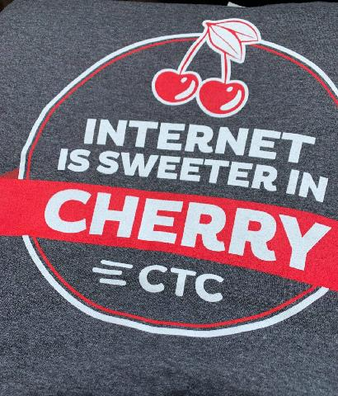
Childcare, Education, Broadband
Notes:
Additional investments in Childcare Development
Childcare: Center Development & Technical Assistance to help those providers navigate the confusion and hire the right experts to help them– Mt Iron, Eveleth, Silver Bay. Regional partnership with the Northland Foundation – leveraging DEED childcare grants, agency grants
Schools: Industry led HS Career Pathways across the Iron Range – Itasca, RR, & Hibbing, trades in the HS via ALI,
Higher Education: MN College North – huge opportunity with the reorganization of MNSCU into MN North College and the highly specialized customized employer training offered via Advanced MN and the ability to obtain an engineering, nursing, or business degree without leaving the range! Via partnership with Bemidji State, Mankato State, & ST Scholastica.
Broadband: Fiber to the business and rural households – Fiber Cooperatives continue to expand their footprint in NE MN! Townships continue to tell me their #1 priority would be improved broadband. Overall, COOK is pretty good but those off the grid now also want broadband – Lake Connections is fairly served but HUGE gaps remain unserved with a network now owned by a company out East, SLC is fairly well served in the core communities on the Iron Range but get 5 minutes out of Hibbing or Virginia and the situation quickly changes – there has been a few wins for SLC recently but they were one of the counties severaly impacted by the preliminary award by the FCC to LTD Broadband (which causes a stalemate – but tahts another presentation too). Itasca County is fortunate to have Paul Bunyan Comm & Arvig expanding. I could give you all a detailed presentation on broadband in NE MN – but instead I say that providing broadband that meets the MN State goal of 100/20 is possible across the state of MN including NE MN. We do not have to rely on wireless. We do need to figure out how to get the federal funding to the townships who don’t even know where to start. KUDOES to the Range Association of Municaplity and Schools for taking on this challenge and being a voice for our small townships. Basically, our region is further along that you may think – opportunities and provider partners are willing to explore projects (if funding is available), and the planning work we did starting in 2018 puts our communities in the drivers seat of their broadband destiny – as they are equipped with good information to make decisions about broadband in their communtiies. And, now, I challenge anyone to a game of does NE MN township have broadband and who are the existing and potential provider partners - LOL.

Slide 10
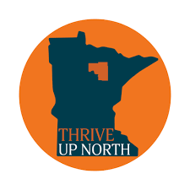
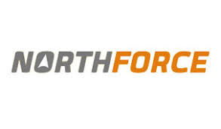
Notes:
Acknowledging the Importance of quality of life, people are looking for the place 1st not the job. Strategic investments as a direct result of regional planning efforts have been focused on making NE MN/the Iron Range a place where people choose to live where they work and play. We have also seen our destination marketing (tourism boards) working directly with the business community to make the connection/get the hook when people to visit to show the opportunity for high quality of life and ability to live and work here! Examples include the THRIVE UP NORTH Itasca County, Northforce & North by Choice – NE MN, Hello Iron Range – IRTB.

Slide 11
Population Shifts
 | 1970 | 1980 | 1990 | 2000 | 2010 | 2020
Aitkin | 11,403 | 13,404 | 12,425 | 15,301 | 16,325 | 15,697
Carlton | 28,072 | 29,936 | 29,259 | 31,671 | 34,958 | 36,207
Cook | 3,423 | 4,092 | 3,868 | 5,168 | 5,211 | 5,600
Itasca | 35,530 | 43,069 | 40,863 | 43,992 | 44,835 | 45,014
Koochiching | 17,131 | 17,571 | 16,299 | 14,355 | 13,461 | 12,062
Lake | 13,351 | 13,043 | 10,415 | 11,058 | 10,900 | 10,905
St. Louis | 220,693 | 222,229 | 198,213 | 200,528 | 199,472 | 200,231
Total | 329,603 | 343,344 | 311,342 | 322,073 | 322,073 | 325,716
Source: US Census Bureau, 1970-2020

Slide 12
Source: Social Explorer, 2010-2020

Slide 13
Changing Age Profiles...
Source: MN DEED, 2022

Slide 14
….And Slowly Changing Demographics
Source: MN DEED, 2022

Slide 15
And Context Matters
MSA | 2000 | 2020 | % Change
South Bend, IN-MI | 316,663 | 324,501 | 2.5%
Scranton-Wilkes Barre, PA | 560,630 | 567,559 | 1.2%
Duluth, MN-WI | 289,276 | 291,638 | 0.8%
Lake Co, IN (Gary) | 484,564 | 485,983 | 0.3%
Toledo, OH | 659,188 | 646,604 | -1.9%
Erie, PA | 280,845 | 270,876 | -3.5%
Flint, MI | 436,141 | 406,211 | -6.9%
Saginaw, MI | 210,039 | 190,124 | -9.5%
Youngstown, OH | 602,978 | 541,243 | -10.2%
Source: US Census Bureau, 2000 and 2020

Slide 16
A Pandemic Era Surge?
Non-Lakeshore Properties
Lakeshore Properties
Source: Range Association of Realtors, 2022

Slide 17
Employment by Sector, 1980-2020
 | 1980 | 1990 | 2000 | 2010 | 2020
Natural Resources | 16,143 | 8,524 | 7,833 | 5,663 | 4,611
Manufacturing | 17,436 | 15,883 | 15,269 | 13,037 | 12,937
Tourism-Related |  |  | 15,435 | 16,345 | 15,959
Health Care & Edu. | 25,047 | 26,788 | 36,136 | 42,854 | 44,702
Total Employed | 131,544 | 128,051 | 148,269 | 151,675 | 153,881
Source: US Census Bureau, 1980-2020

Slide 18
Industries as a Percent of Overall Employment
 | 1980 | 1990 | 2000 | 2010 | 2020
Natural Resources | 12.3% | 6.7% | 5.3% | 3.7% | 3.0%
Manufacturing | 13.3% | 12.4% | 10.3% | 8.6% | 8.4%
Tourism-Related |  |  | 10.4% | 10.8% | 10.4%
Health Care & Edu. | 19.0% | 20.9% | 24.4% | 28.3% | 29.0%
Source: US Census Bureau, 1980-2020

Slide 19
NE MN Economic Base Analysis, 2021-2022
Transforming |  | Growing Base
Natural Resources & Mining | 3.42 | Public Administration | 1.70
Education & Health Services | 1.28 | Leisure & Hospitality | 1.42
Construction | 1.04 | Other Services | 1.09
Declining |  | Emerging
Financial Activities | 0.58 | Trade, Transp. & Utilities | 0.95
Professional & Bus Services | 0.45 | Manufacturing | 0.55
Source: MN DEED QCEW, 2011 and 2021

Slide 20
Wages by Industry, 2020
Source: MN DEED, 2022

Slide 21
Mining Is Not Dying!
Source: MN Department of Revenue and US Geological Survey, 2002-2021

Slide 22
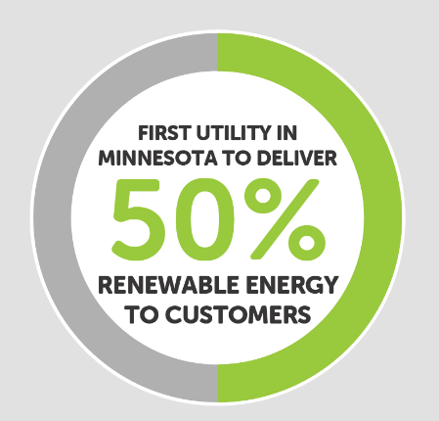
MINNESOTA POWER’S ENERGYFORWARD TRANSITION
Yesterday
Nine coal units
95% of energy from carbon sources
Today
First Minnesota utility to deliver 50% of energy from renewable sources
7 of 9 coal units closed or transitioned
50% reduction in carbon
Achieving state standards a decade early
Tomorrow
100% carbon-free energy by 2050
Minnesota Power | 100% Carbon-Free Energy Vision

Slide 23
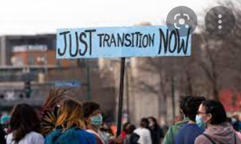
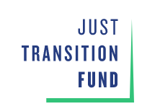
Energy Transition – A Focus of Many
Notes:
History of MP transition plan, coal communities and their tax bases, factors driving all of this (Arik)

Slide 24
Realities of Rural Economic Development
Disconnect between policy and rural economics
Small communities unaware of resources, or lack resources/staff capacity, and may not have budgets to expand it
Regional entities can do things at scale, but may not have authority or boots on the ground necessary to make projects happen
Regions get lumped together in complicated or different ways by different entities
Notes:
K

Slide 25
Covid-19 Funding Rush
There’s suddenly money for all the things
Relatively few strings attached
Chances to plan proactively
Meeting priorities, not just chasing money
Notes:
Yay there’s suddenly money for all the things
Doing it in a way that meets our priorities, not just chasing money
Karl
Note: BBB is federal EDA $$ - we just finished our CEDS which really supports many initiatives already started – what could a boost of funding do for some of those efforts
Note: BBB prioritizes rural communities – energy transition community support is hot topic in the state/Midwest/world – how do we provide additional resource to our coal communities but think regionally too
Note: BBB wants you to identify a regional cluster – how do we do this in rural when we need to support the entire rural ecosystem – TEHCNOLOGY/Broadband is the thread the ties together our BBB proposal
We did the CORI STUDY??? Had already been done in Itasca – expand to region.
What does a sustainable rural economy & comprehensive strategy look like when your cluster strength is natural resources – TIMBER, TACONITE, & TOURISM – add in technology and the use of it (Examples – Innovate 218, NRRI Commercialization, Fiber to the Business)

Slide 26
Build Back Better Regional Challenge
Competitive grant application process from federal EDA
Regional in scale with coal communities emphasis
Opportunity to re-frame regional economy with an emphasis on technology-infused traditional industries (timber, taconite, tourism, technology)

Slide 27
NE MN Build Back Better
Northeast Minnesota seeks to develop a prosperous 21st century rural economy through the creation of a digital ecosystem that re-envisions regional industries and ignites innovative, equitable entrepreneurship.
Notes:
Build off and align with major outcomes of Regional Planning Efforts
12 member coalition
Increase Support to Coal Communities
Focus on increasing the Technology as it relates to Taconite, Timber, & Tourism
Supercharge and support existing efforts:
Increased Entrepreneurship: Innovate 218
Workforce: Welcoming Communities
Broadband: Fiber to the Downtown/Business Corridor
Business Development: Building Rehab & Site Readiness for local expansion and recruitment
Cluster Commercialization Efforts: Biomass/Advanced Carbon & Energy Storage
Coal Communities Support: Digital Economy & Asset Reuse

Slide 28
Northeast MN BBB Projects
Asset and cluster analyses for coal communities
Building rehabilitation and shovel ready site work
Downtown broadband projects
Innovate 218 integration
Knowledge workforce development
NRRI non-battery renewable energy storage
NRRI biomass energy and advanced carbon products

Slide 29
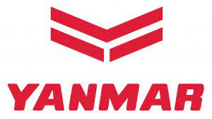
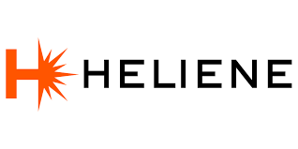
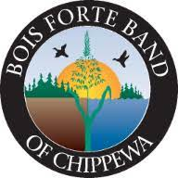
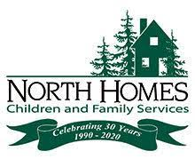
NE MN Good Jobs Challenge
185,600 jobs projected to be filled
NHED opportunity due to reorganization to MN North College
Based on proven pilot program Empower
Change the model
Local businesses sign MOU’s committing to hire workers out of the training
82 jobs with avg $45,940 or $22/hour
Overall impact 1700 individuals
Over 30 direct partners
Notes:
Describe Good Jobs Challenge Opportunity / why we need to plan for this/ what we did based on proven program
What do we do in rural – we don’t have Rochester/Mayo – close to the Twin Cities. We are a rural area the size of West Virginia. 70 cities, 180 townships, and five tribal nations (Leech Lake, Fond du Lac, Mille Lacs, Bois Forte, and Grand Portage). The region has a robust industrial sector tied to the area’s abundant natural resources. MN College North reference – add in logo
185,600 openings to fill by jobs left vacant by retirements and other career changes.
Personal care, healthcare, community, social services, and construction and extraction occupations
NHED opportunity due to reorganization
Proposal is based on proven Empower Program
Financial assistance for tuition, childcare, transportation, study assistance, and loan forgiveness
Supported over 100 women in our region secure quality jobs in nontraditional careers
Expands Empower to priority industries aligning with employer MOU’s.
Transition our NE MN workforce systems from a transactional (how is the individual performing in the system) to a transformation approach (how is the system working for the individual).
The total initial commitment for regional employers includes 82 jobs, with an average wage of $45,940 or $22 per hour.
MOUs from regional employers in primarily manufacturing & health care & tribal government.
This investment will ensure that over 1700 individuals have equitable access to the skills and resources needed for good jobs in northeast Minnesota.
Over 30 partners directly involved including K-12 Career Academies, Industry, & Economic Development Partners. MN College North is backbone agency.

Slide 30
Developing projects that fit the narrative
Heliene – Technology
Detroit Reman – Technology
Huber - Timber
MP transition (solar, natural gas)
ASV - Manufacturing
Notes:
Keep this slide???

Slide 31
Welcome to Cohasset – A Case Study
Boswell Local Impact | Tax Base
City of Cohasset | 69%
Itasca County | 13%
Grand Rapids School District | 19%
By The Numbers | Tax Base
Direct Jobs | 170
Power Generation | 922.5 MW
Off Coal Date | 2030 – Unit 3* 2035 – Unit 4*

Slide 32
An Economic Developer’s Dream Host Community Project
By The Numbers | Huber
Direct Jobs | 150
Capital Investment | $440M
Avg Wage | $30+/hour

Slide 33
Dueling Headlines
Notes:
Whitney and Karl pile on as they see fit – stuff in rural just is not at the scale at the metro – its different.
Funding housing projects in rural areas
Other permitting garbage we’ve encountered
Unrealistic expectations of capacity

Slide 34
Conclusions
Rural economic development requires regional solutions, and tools don’t always fit situations well
Lots of decisions about rural economic development get made in non-rural places
Getting things done requires the creation of formal and informal structures for collaboration
The process requires vision and seeing how all the parts fit together
Even in the best case scenarios, it’s not always easy!

